Slide 1
GENE EXPRESSION ANALYSIS OF LEUKEMIA V/S NORMAL CELLS

Slide 2
INTRODUCTION:
Cancer is a complex group of diseases characterized by the uncontrolled growth and spread of abnormal cells.
Currently, it is one of the leading causes of death in the world.One such type of cancer is blood cancer. Blood cancer is a type of cancer that affects blood cells.
The common types of blood cancers include myeloma, leukemia, lymphoma, myelodysplastic syndromes, among others.
Leukemia occurs most often in adults older than 55, but it is also the most common cancer in children younger than 15.

Slide 3
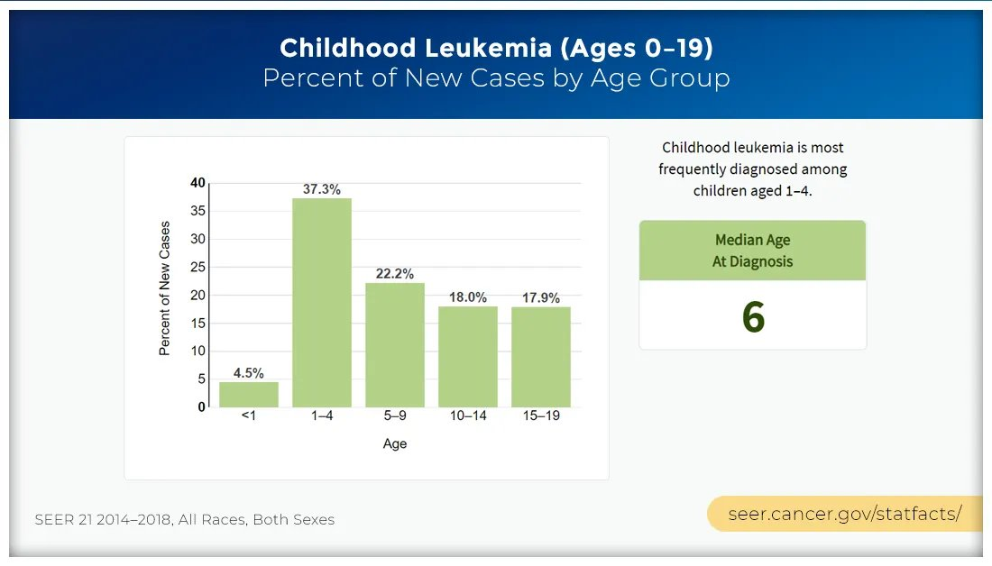

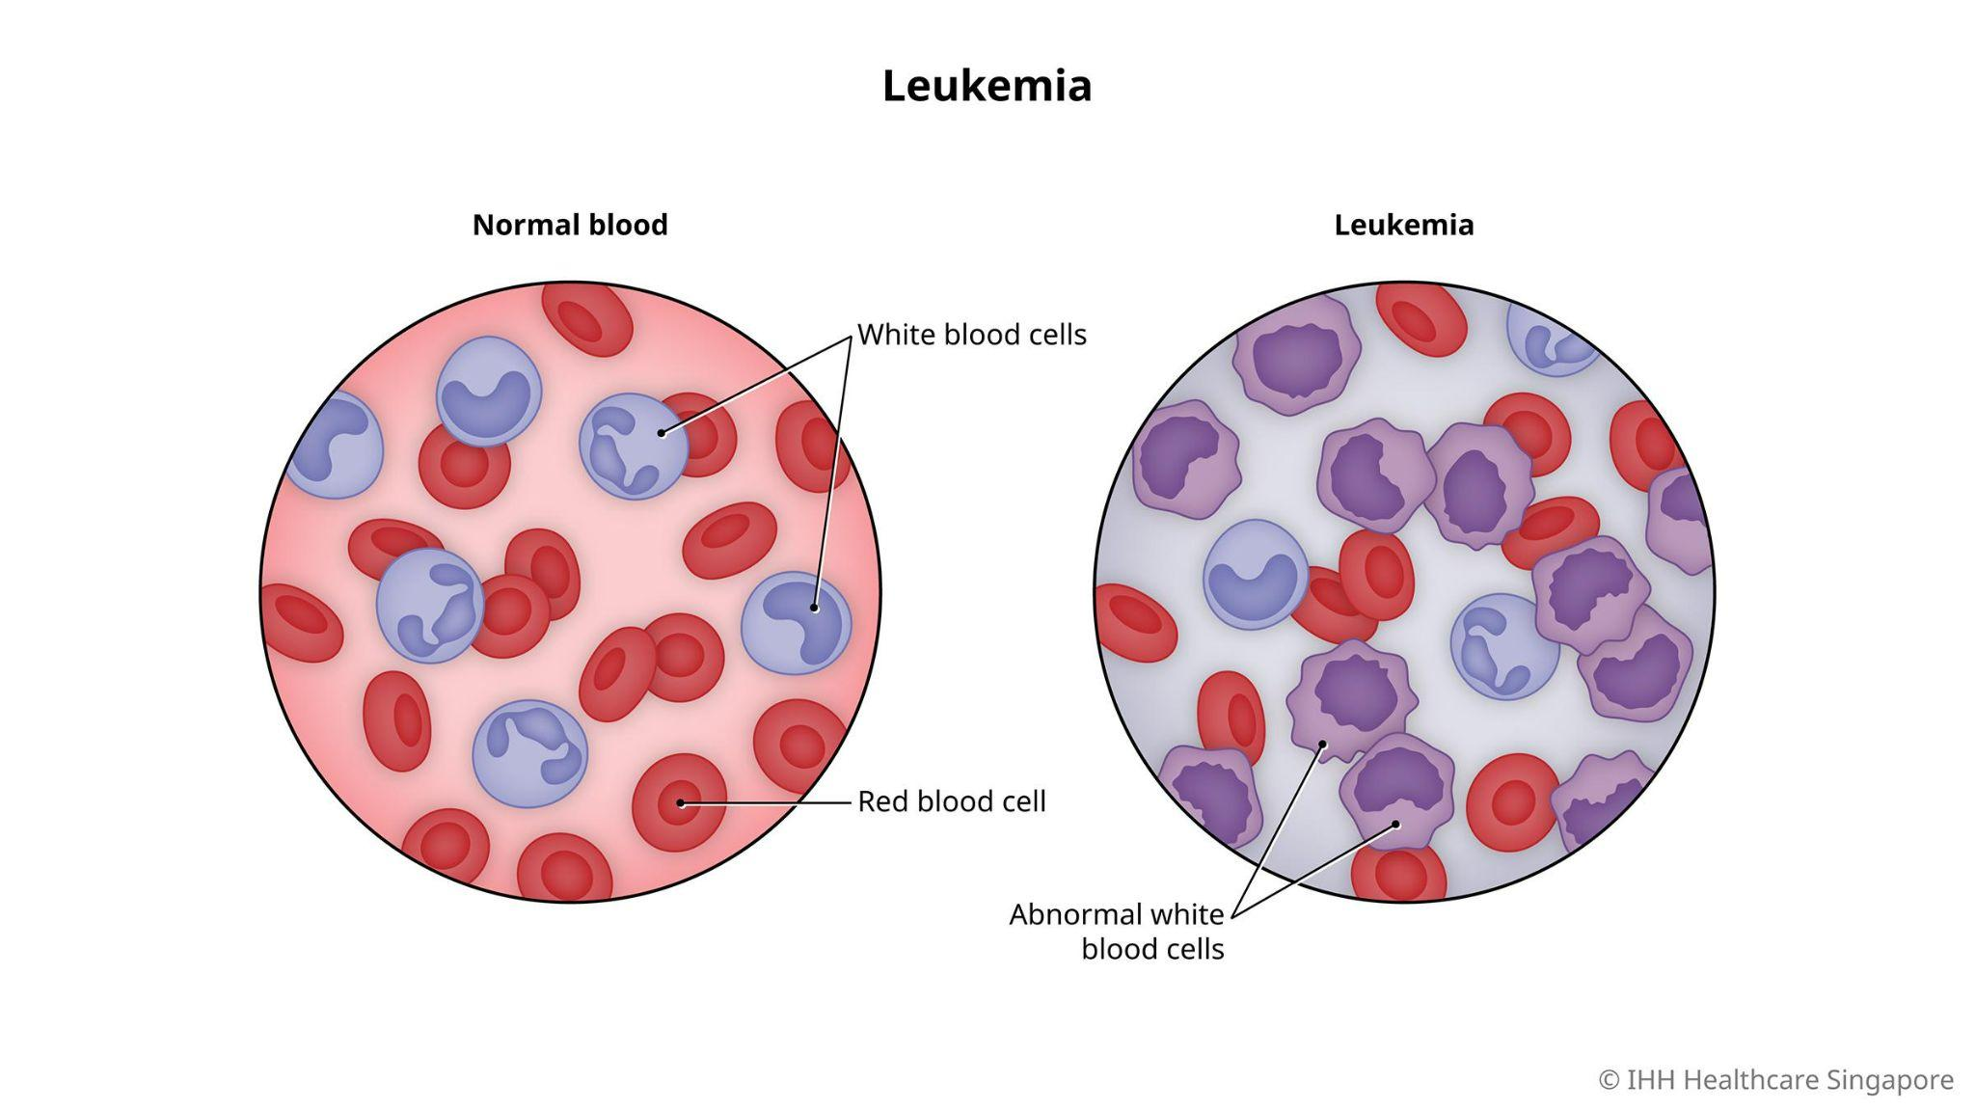

Slide 4
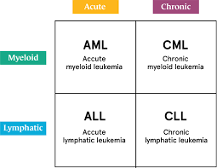
Abstract:
TYPES OF LEUKEMIA-:
1)Acute Lymphocytic Leukemia (ALL)- Most common kind of leukemia. It usually occurs in young children but can also occur in adults.
2)Acute Myelogenous Leukemia (AML)- Most common kind of aggressive leukemia in adults. It can also affect children. This type of leukemia starts in the myeloid cells of the bone marrow and can spread quickly into the blood.
3) Chronic Lymphocytic Leukemia(CLL)- Most common type of slow-growing leukemia. It usually affects older adults.
4) Chronic Myelogenous Leukemia(CML)- Usually affects adults. It’s sometimes called chronic myeloid leukemia.

Slide 5
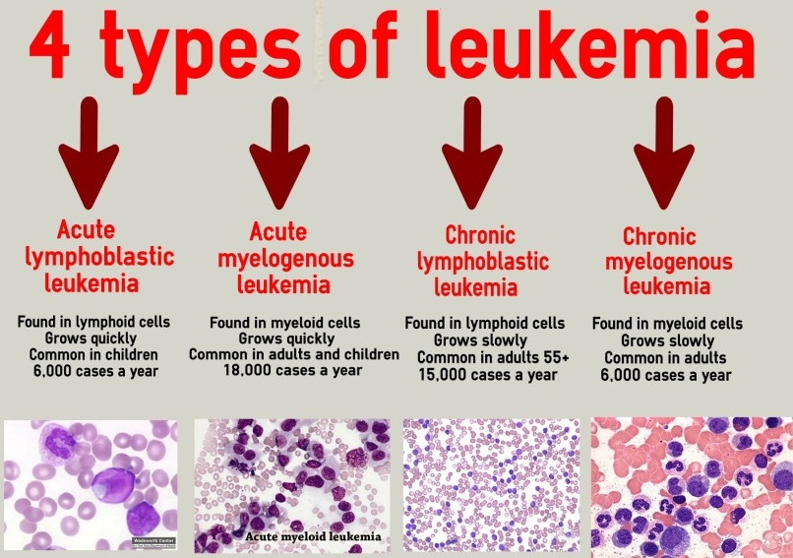

Slide 6

Problem Statement:
Despite advances in medical science, leukemia remains a significant health challenge worldwide, characterized by diverse subtypes and variable patient outcomes.
The diagnosis process is costly and time-consuming involving medical experts and several tests. Thus, an automatic diagnosis system for its accurate prediction is of significant importance.
Traditional diagnostic methods can sometimes be invasive, costly, and time-consuming. Furthermore, they may not always provide the comprehensive molecular insights needed for personalized treatment strategies.

Slide 7
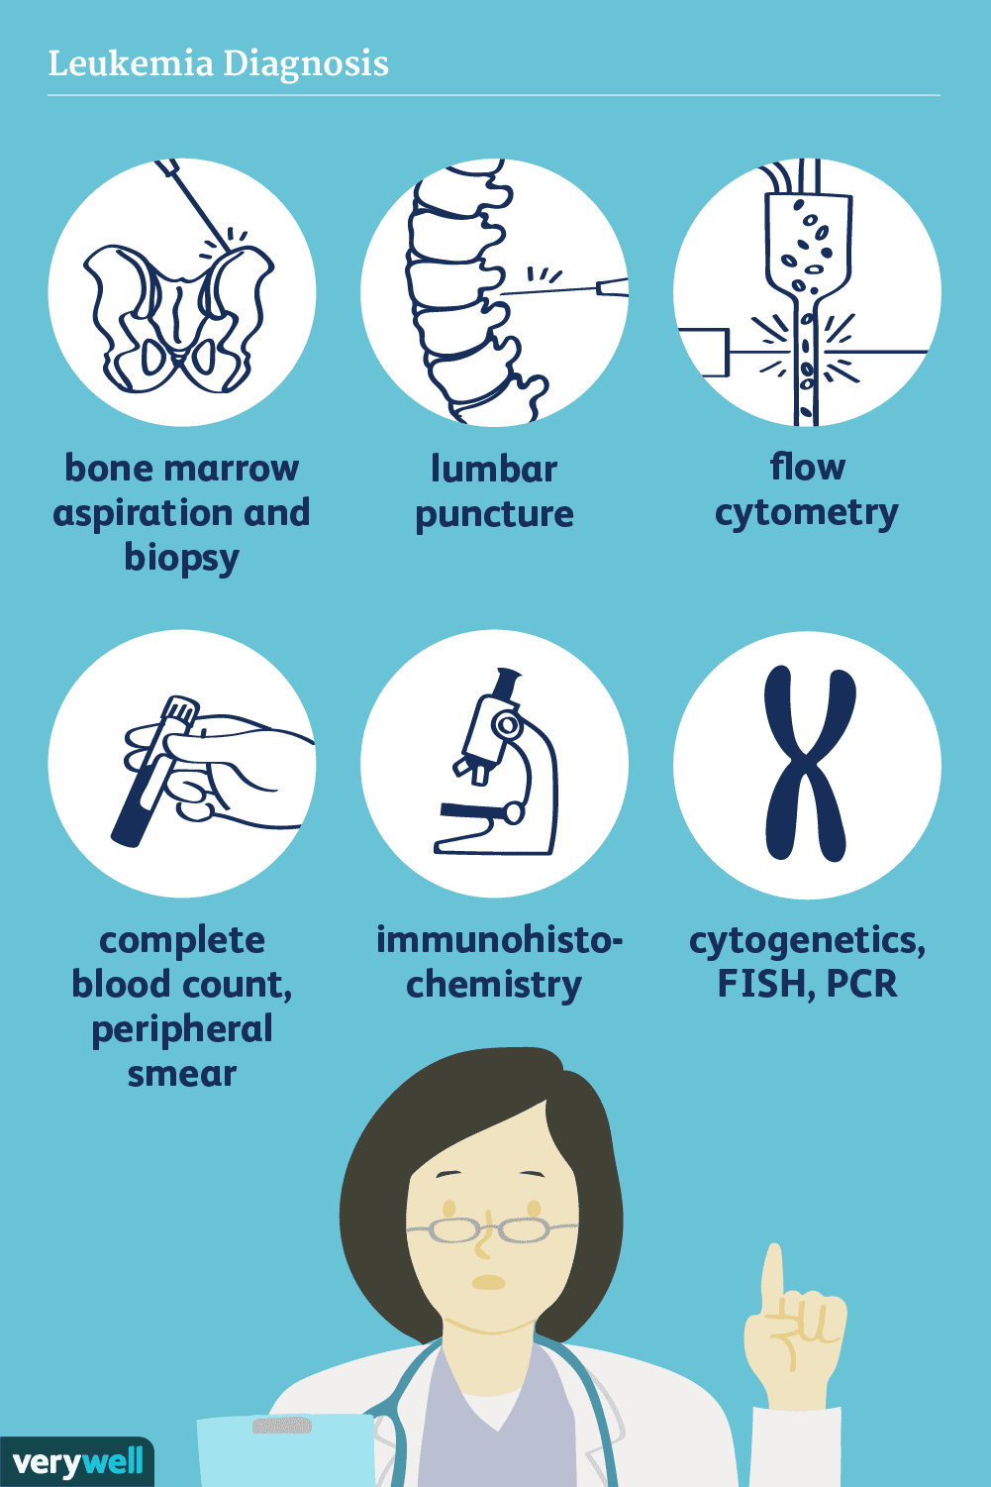
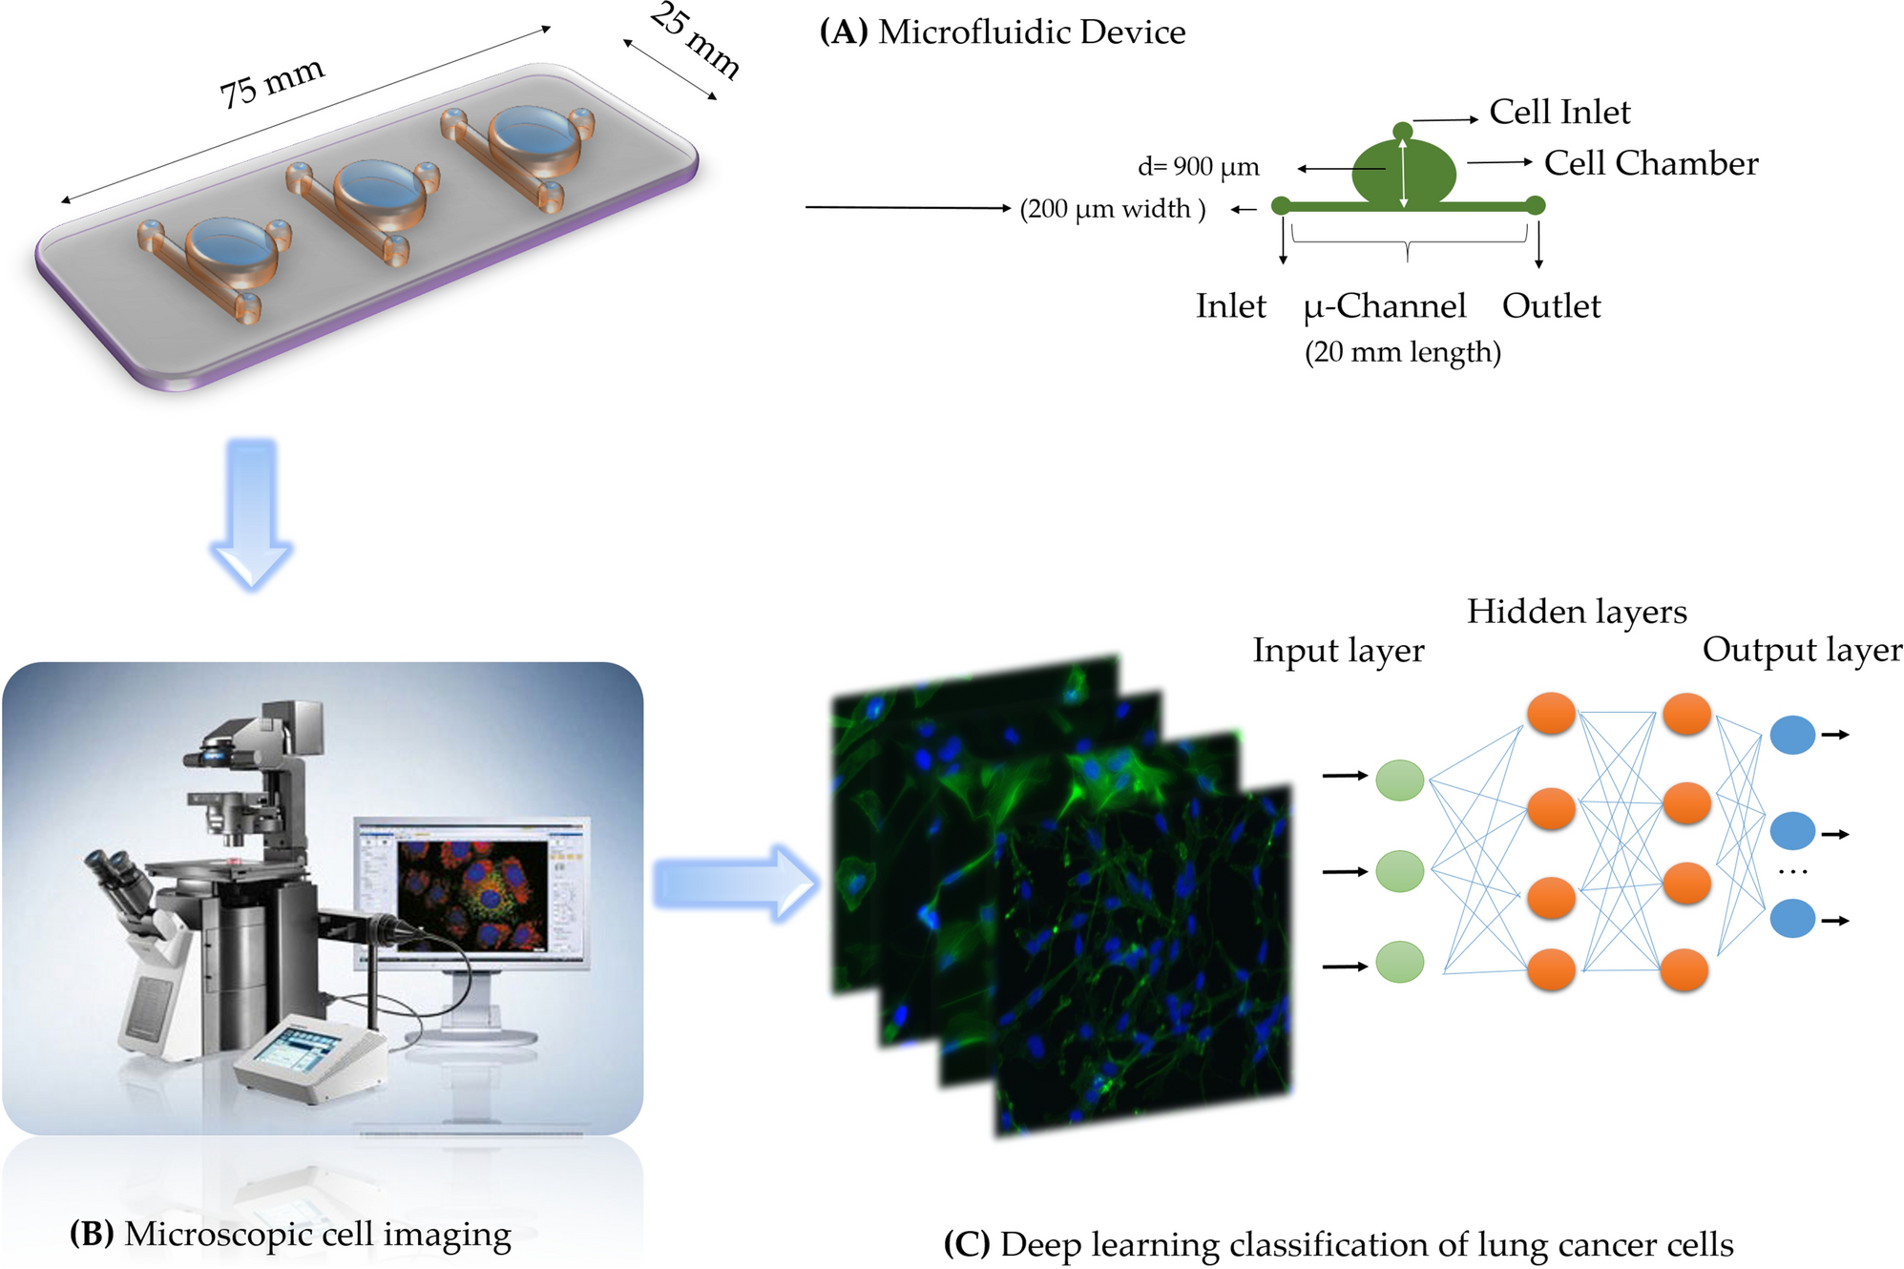
Problem Statement:

Slide 8
Possible solution:
The leading cause of cancer is present in the mutation in our genome.So we can use the gene expression data,genomics,transcriptome analysis for early detection of leukemia cells.
One potential solution is by Diagnosis of blood cancer using leukemia microarray gene data and machine learning or statistical approach .
In this method we would use the gene expression data from Gene Expression Omnibus(GEO) - NCBI. https://www.ncbi.nlm.nih.gov/geo/
https://www.ncbi.nlm.nih.gov/geo/query/acc.cgi?acc=GSE28497 and https://www.ncbi.nlm.nih.gov/geo/query/acc.cgi?acc=GSE9476
We first would do feature engineering on our dataset to get the high quality data hence increasing the accuracy of the model.
Then we could use the statistical tools like K-nearest neighbour,Support vector machine,Linear discrimination analysis,T-test or ANOVA etc.for training our model which could be used for early diagnosis with high accuracy.

Slide 9
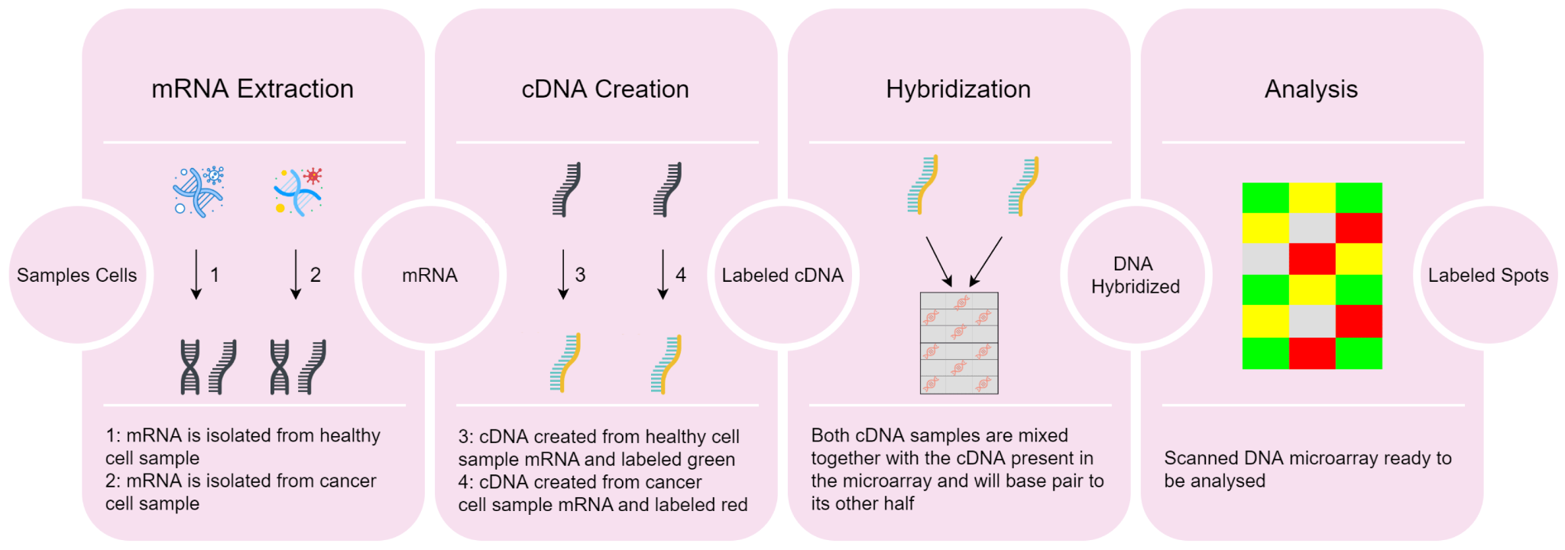
Possible solution:
Pipeline for Cancer Detection on Microarray Data:
E

Slide 10
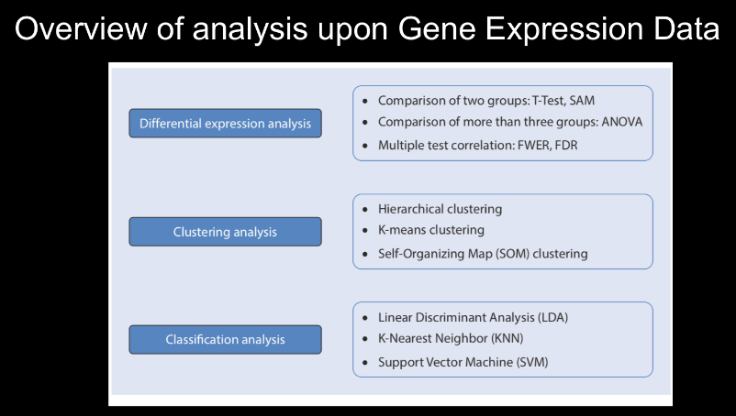
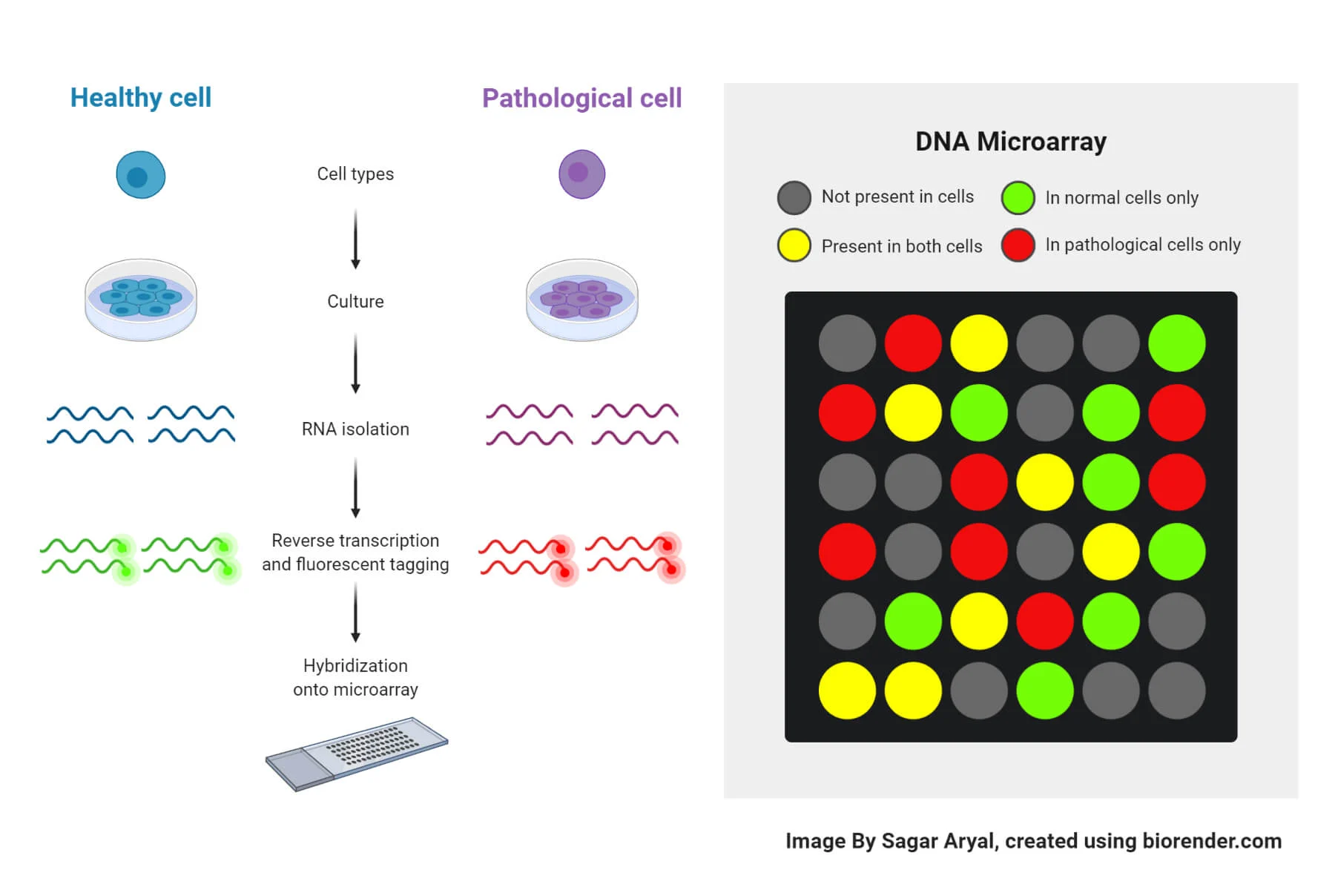
Possible solution:
E

Slide 11
Feasibility Of Project and future plan:
As Acute leukemia is more aggressive than chronic leukemia,So initially We plan to work only on Acute Lymphocytic Leukemia and Acute Myelogenous Leukemia.
If we would have sufficient time and good quality data we would also try to incorporate the chronic leukemia in our model.
Reviewing the past literature,we found the gene expression data can be used with good quality of feature engineering, performing suitable statistical test,selection of suitable machine learning algorithms we could attain the accuracy of around 70%.
Further, a statistical significance T-test is also performed to show the efficacy of the proposed approach.
Major challenge we would likely face is the low accuracy due to low amount of data,which we would try to solve by using techniques like synthetic data generation,data augmentation etc.
Moreover we can use the transfer learning technique in which we could fine tune the largely trained model on our dataset.Some literatures have also shown very high accuracy(about 96%) by using some deep learning techniques like CNN, ANN, LSTM. And the newly came Transformer Architecture also have feasibility to work on large dataset to give high accuracy.

Slide 12
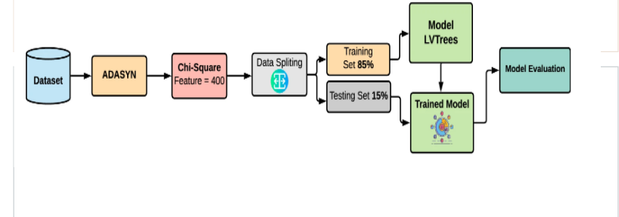
We may follow the general flow as given:

Slide 13
Dataset:
In this we would use the dataset:
Having accession no GSE28497 from NCBI-GEO database,For Acute Lymphocytic Leukemia.The dataset contains 281 samples, 22,285 genes (features), and seven target classes https://www.ncbi.nlm.nih.gov/geo/query/acc.cgi?acc=GSE28497
Having accession no GSE9476 from NCBI-GEO database,For Acute Myelogenous Leukemia https://www.ncbi.nlm.nih.gov/geo/query/acc.cgi?acc=GSE9476

Slide 14
Data description and basic flow
Dataset contains the 22,285 genes (features),from 270 patients and normal CD19 CD10 B-cell progenitors (n=4).
22,285 different probes are used for identifying the 22,285 genes.
Probes are represented by ID_REF For instance, "1007_s_at", "1053_at", "117_at.
Value represent the intensity of microarray scanner.
ABS_CALL represent if the intensity is detected above background level or not.
P-value is a measure used to determine the significance of an observed result.
The data were analyzed with Microarray Suite version 5.0 (MAS 5.0) using Affymetrix default analysis settings and global scaling as normalization method. The trimmed mean target intensity of each array was arbitrarily set to 500.
The downloaded file is in the .CEL.gz format, So we may first convert to .csv file so then we will convert to pandas dataframe.
So We Would split the data in 85% as training data and 15& as testing data.
By using different techniques we will try to increase the accuracy of our model.

Slide 15
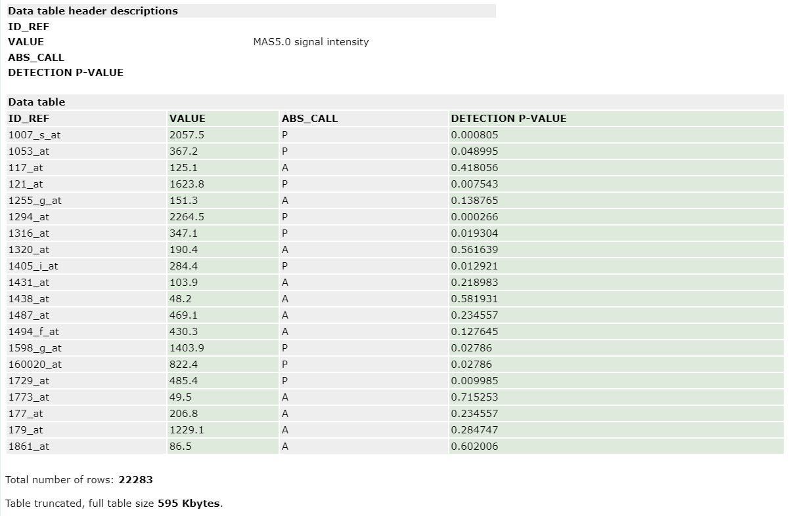

Slide 16
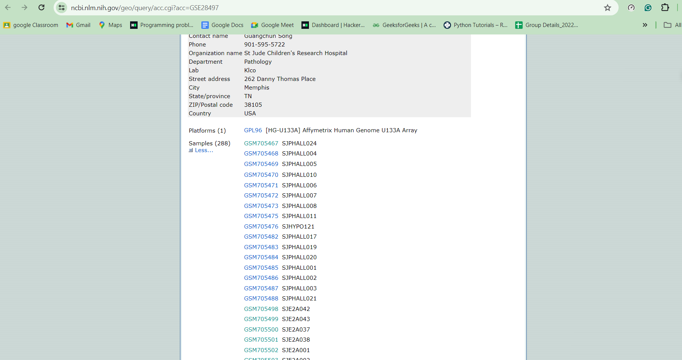
DATA COLLECTION:
First we are collecting data of unhealthy and healthy cells and then converting it to csv from GEO by using their Accession number

Slide 17
WORKFLOW
DATA COLLECTION & Labelling
Removing Null Values
T-test &
Plotting Volcano Plot
Performing PCA & SOMET
Selecting Important features & Normalisation
Plotting Heat Map
Applying various ML models
Plotting Accuracies and tried DL model

Slide 18
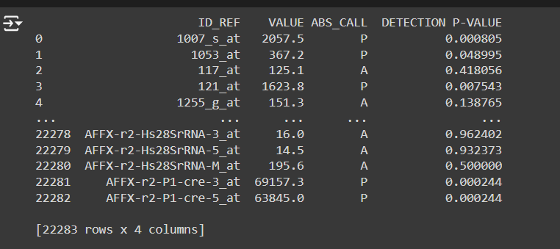
DATA COLLECTION:
Shape of data is 22283*4

Slide 19
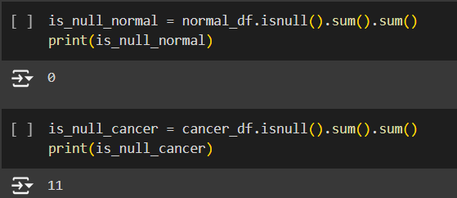
Handling Null values:

Slide 20
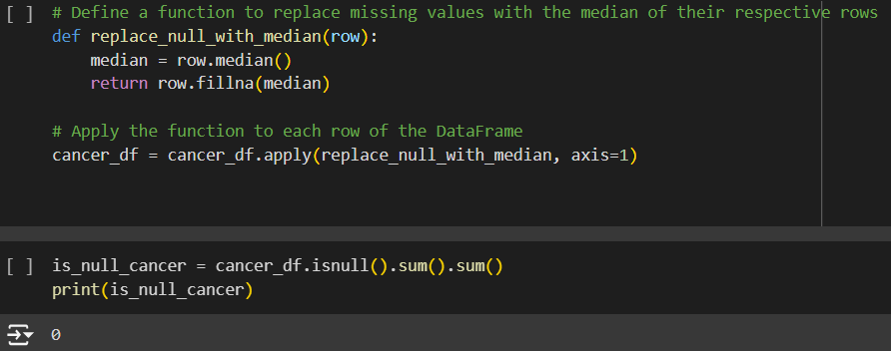
Handling Null Values:
Missing values in cancer is to be replaced by median

Slide 21
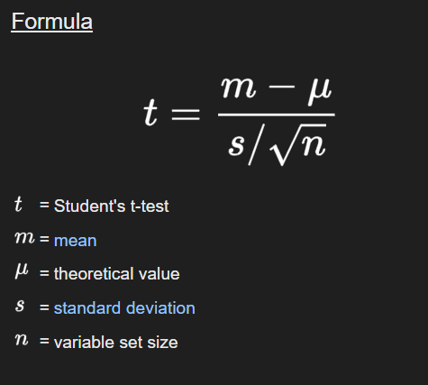
Formula of t-test:

Slide 22
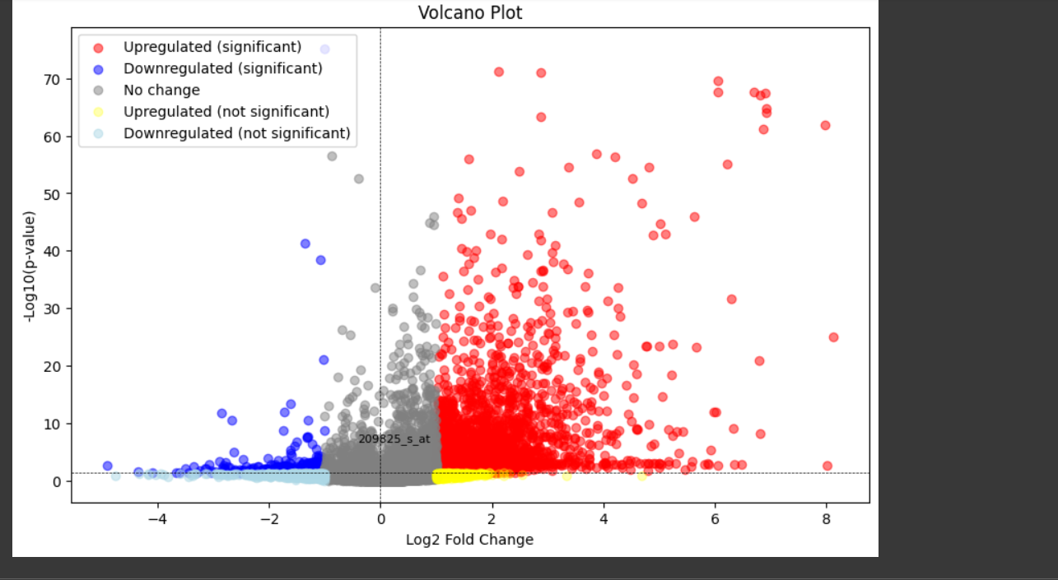
Notes:
Each point on the graph represents a gene. the most upregulated genes will be towards the right, they have a positive fold change.
the most downregulated genes are towards the left, they have a negative fold change.
The y axis shows how statistically significant the gene expression differences are: more statistically significant genes will be towards the top (lower p-values).
Fold change threshold,we set as 1 and p_value_threshold as 0.05
This graph is divided into 4 parts-
the top right genes with significant upregulation
Top left genes with significant downregulation
Bottom right genes with upregulation but not significant
Bottom left genes with downregulation but not significant
Fold change is the ratio of the gene expression of the two groups.

Slide 23
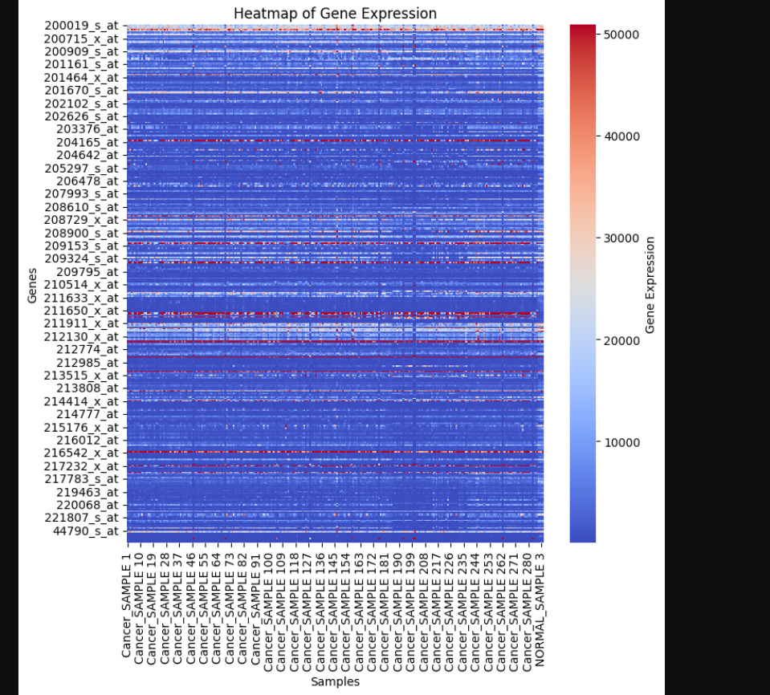
Notes:
Rows represent genes.
Columns represent samples that we hv collected.
color gradient is used to represent different levels of expression. here, red indicates high expression, blue indicates low expression, and shades in between represent intermediate expression levels.
Both rows (genes) and columns (samples) can be clustered to group similar expression patterns together.
Normal sample-healthy ppl-who dont hv cancer

Slide 24
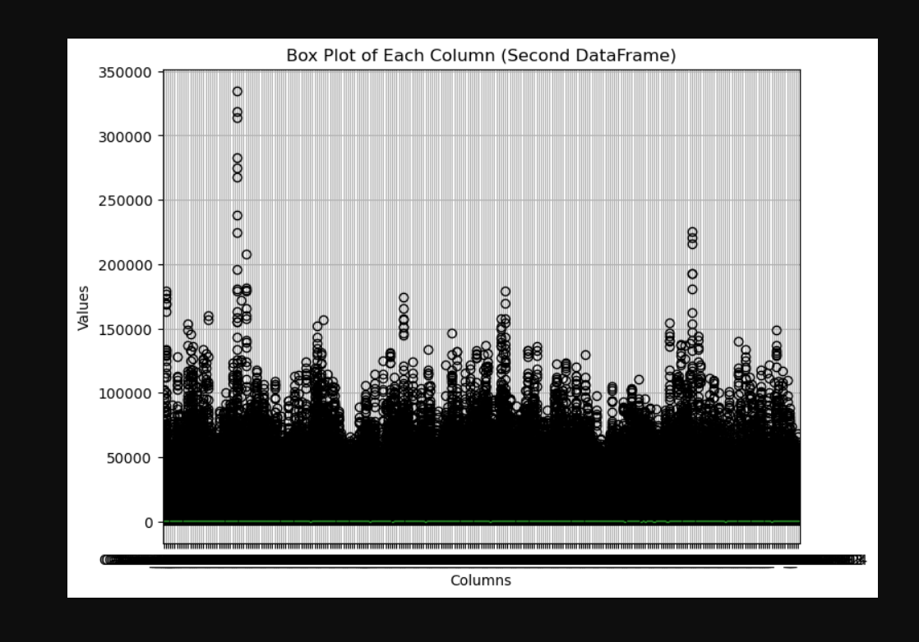
The following represents Box Plot having “Expression” at y axis and “Features” at x axis

Slide 25
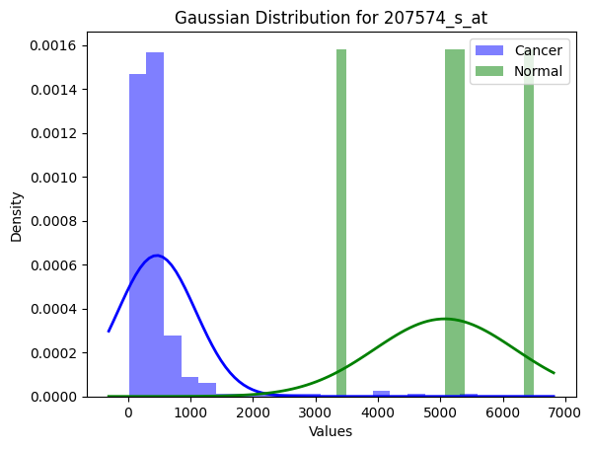

Slide 26
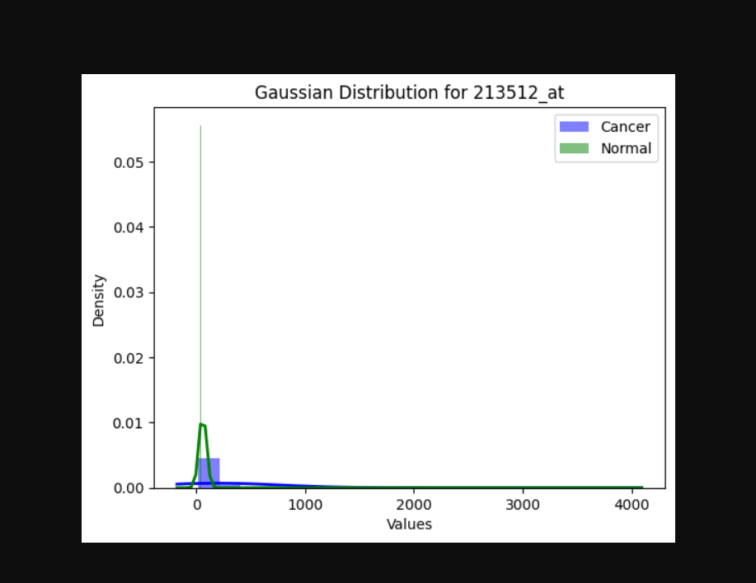

Slide 27
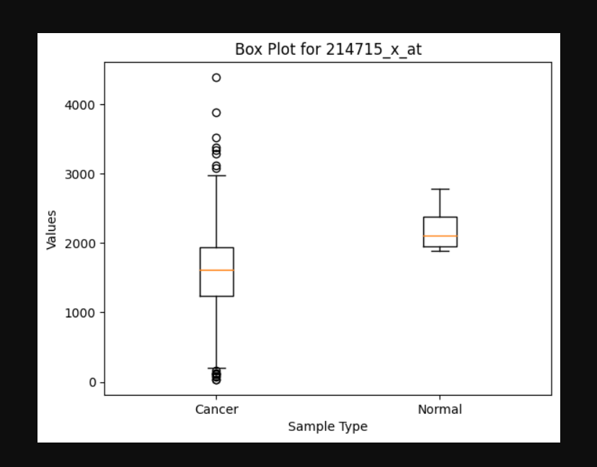

Slide 28
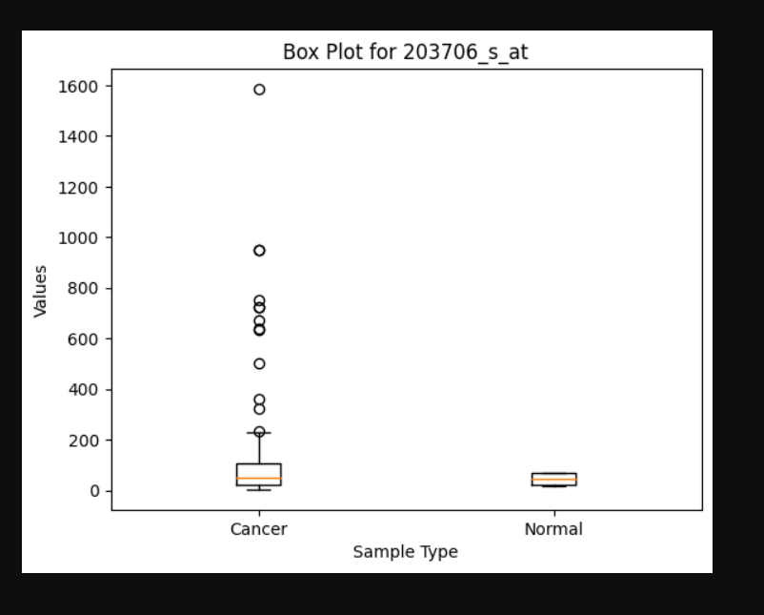

Slide 29
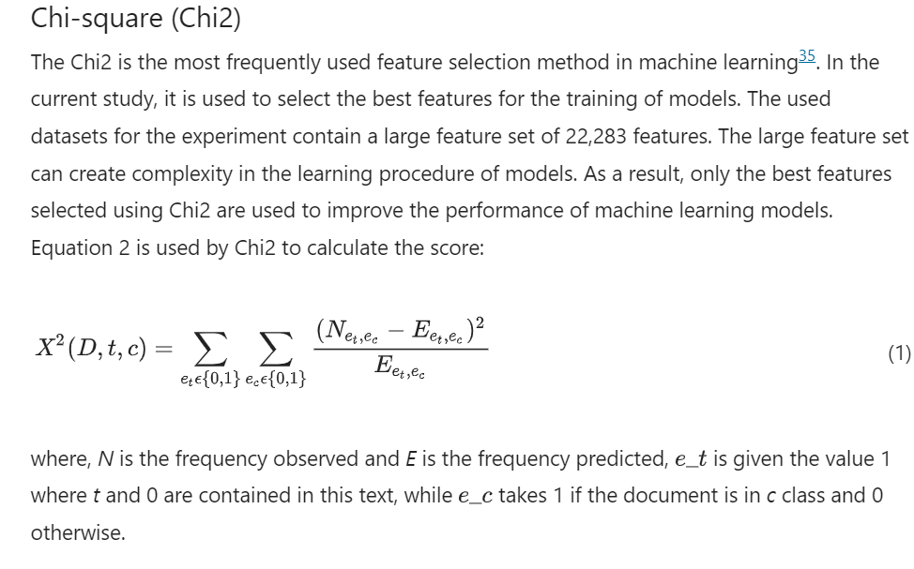

Slide 30
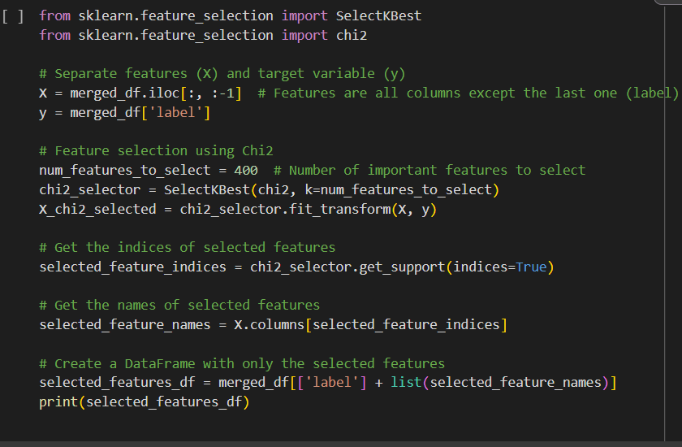

Slide 31
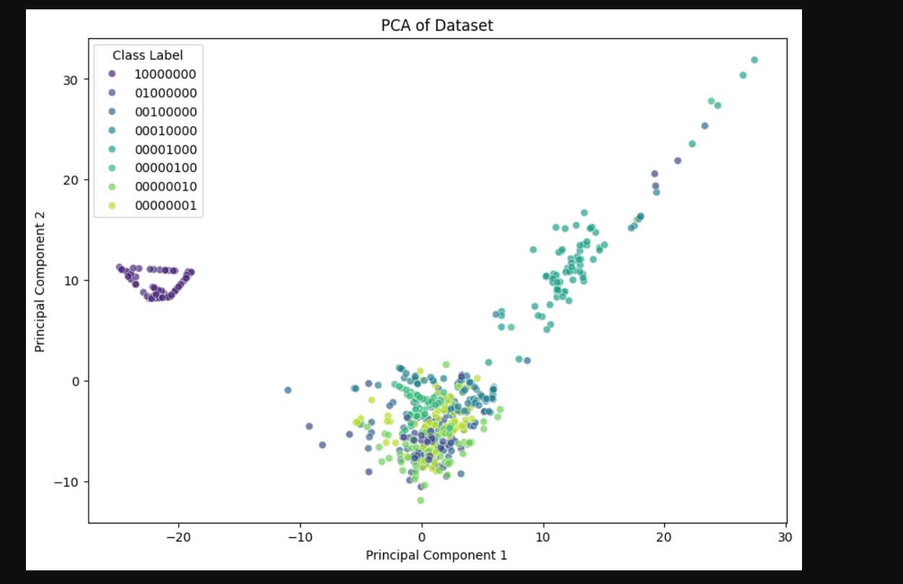
Normal1-10000000
B-CELL_ALL_ETV6-RUNX1-01000000
B-CELL_ALL-00100000
B-CELL_ALL_MLL-00010000
B-CELL_ALL_T-ALL-00001000
B-CELL_ALL_TCF3-PBX1-00000100
B-CELL_ALL_HYPERDIP-00000010
B-CELL_ALL_HYPO-00000001

Slide 32
Applying PCA for Dimensionality reduction

Slide 33
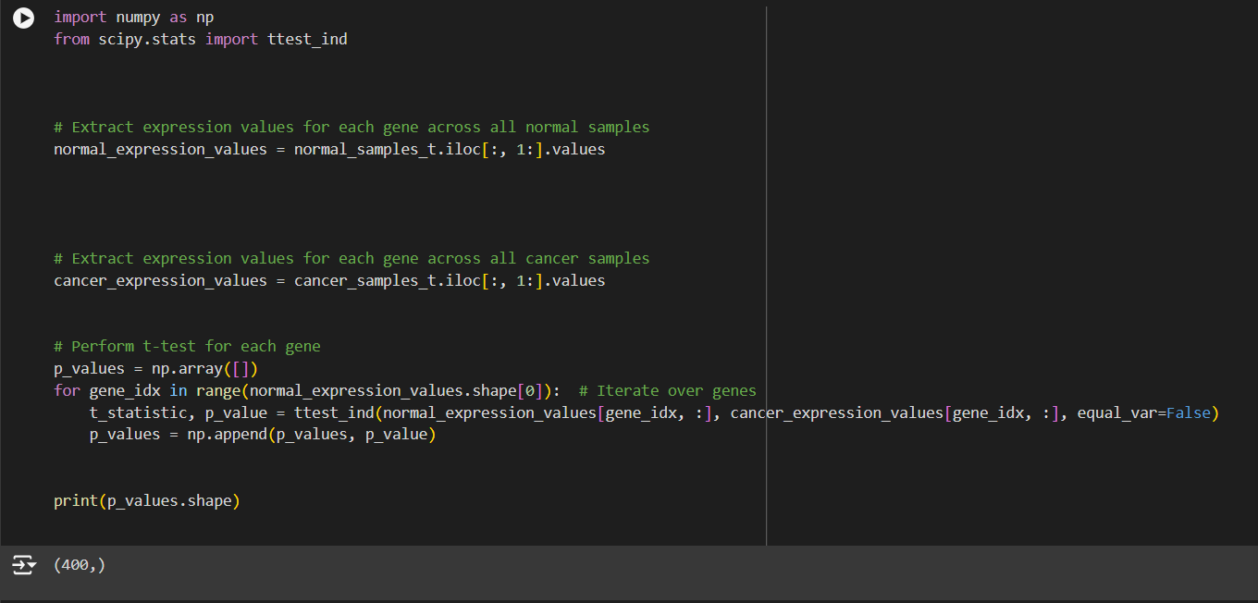
Applying T-test

Slide 34
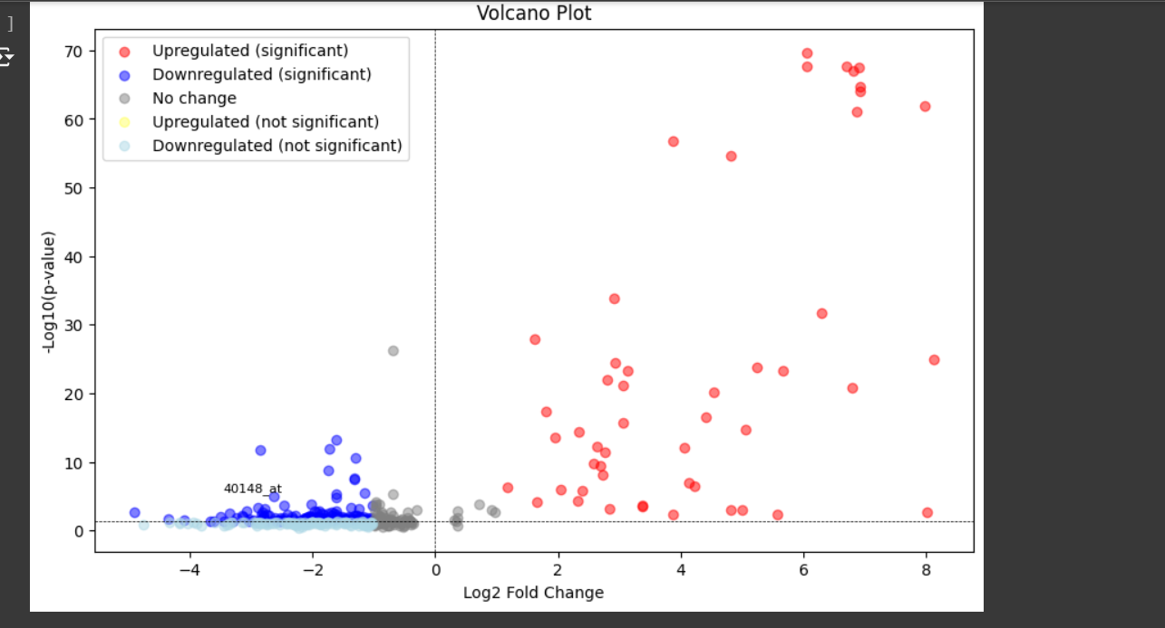
Volcano PLot
After CHI test
Notes:
After applying pca, this is the volcano plot that is obtained.
In brief,
Before Feature Reduction:
All the genes are plotted.
The plot is cluttered and may include many non-significant points.
After Feature Reduction:
Only significant genes with meaningful fold changes are plotted.
The plot is clearer and more focused, highlighting the most important genes.

Slide 35
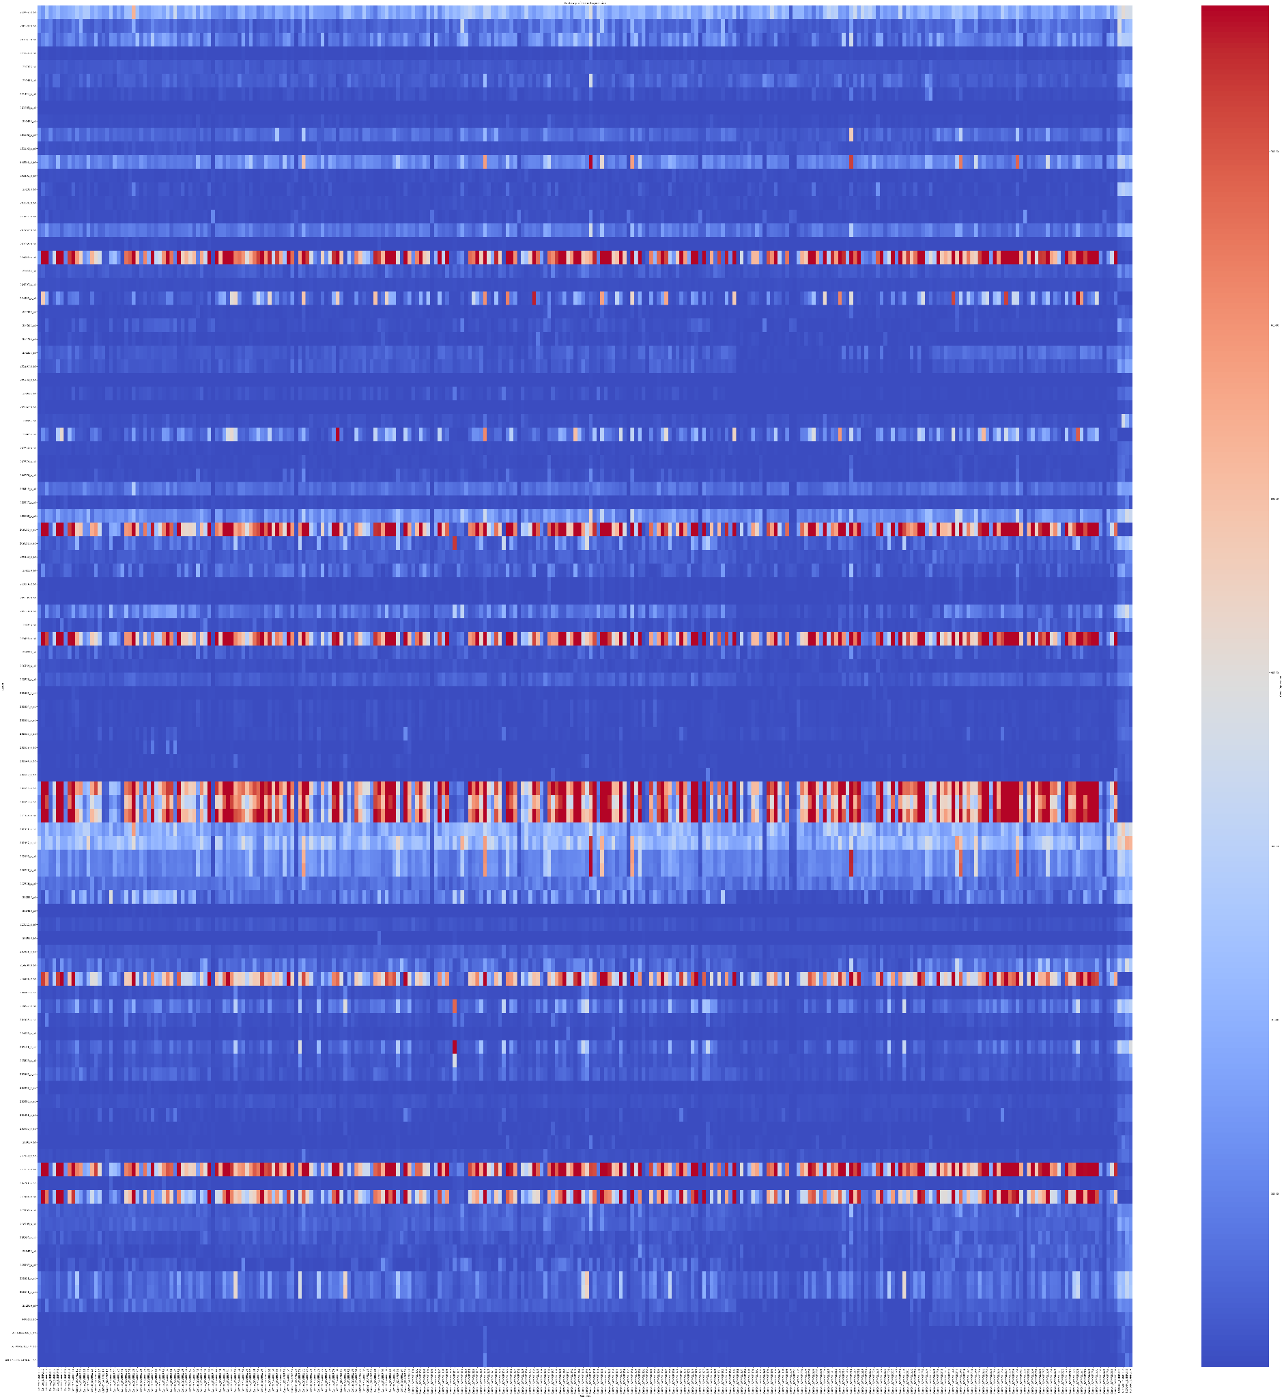
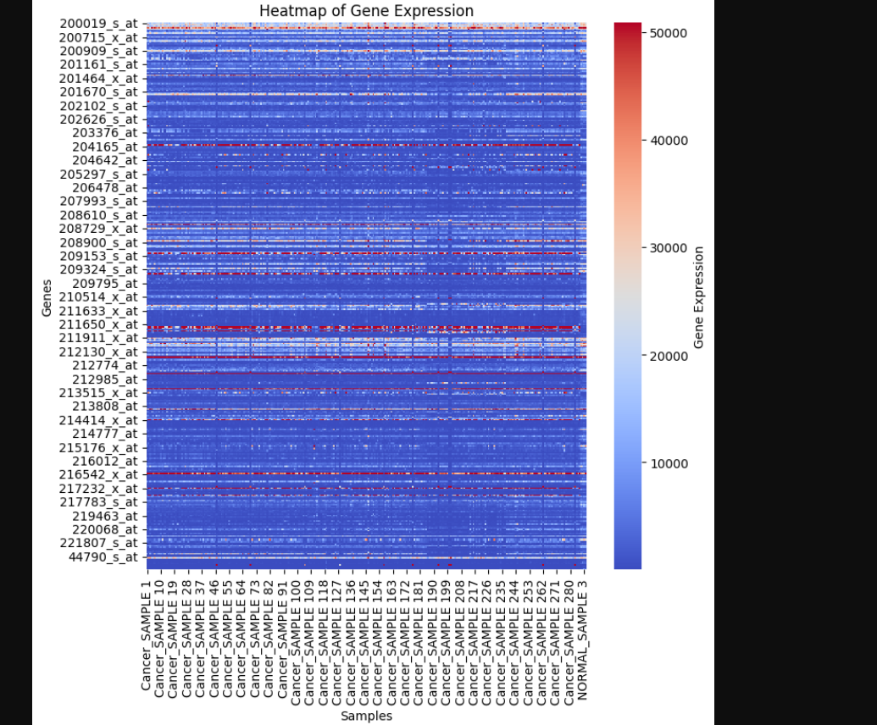
Heatmap after
Feature reduction
Notes:
Before Feature Reduction:
Displays all genes.
The heatmap may be cluttered with noise, making it hard to discern patterns.
After Feature Reduction:
Displays only differentially expressed genes (DEGs).
The heatmap is clearer, highlighting important patterns and changes in gene expression between conditions or samples.

Slide 36
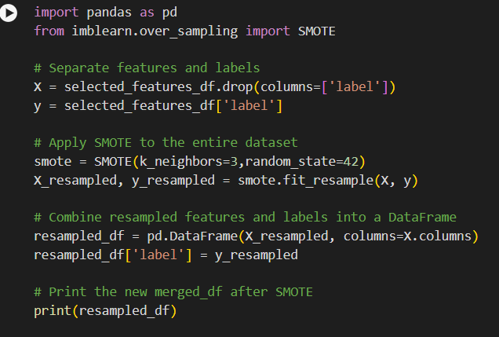
Using SMOTE

Slide 37
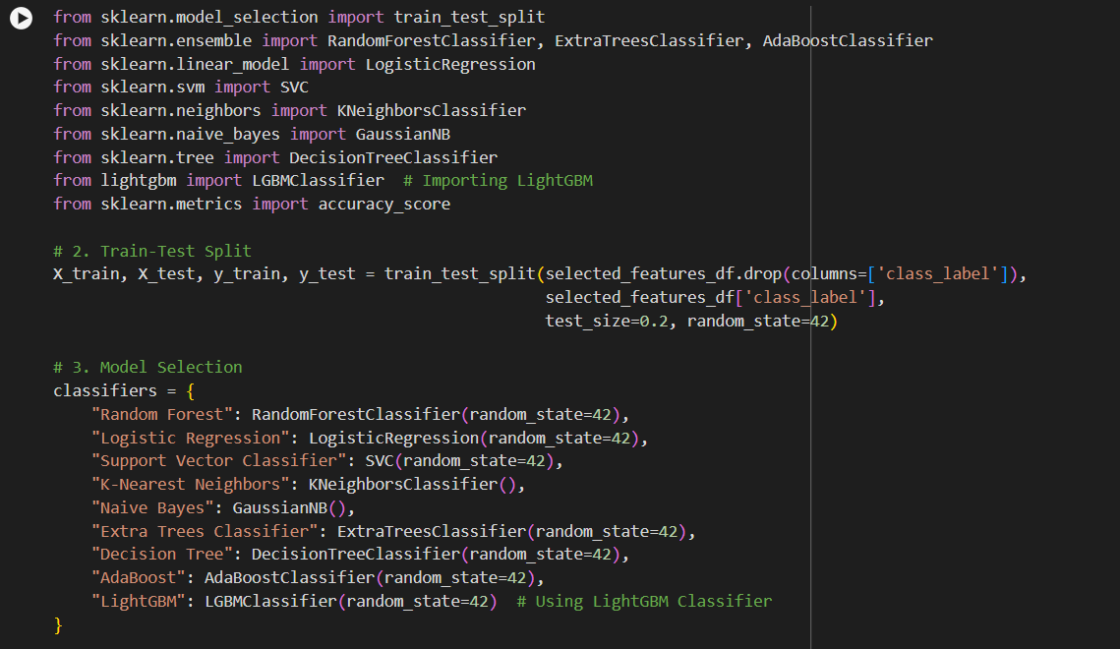
Using ML-
models

Slide 38
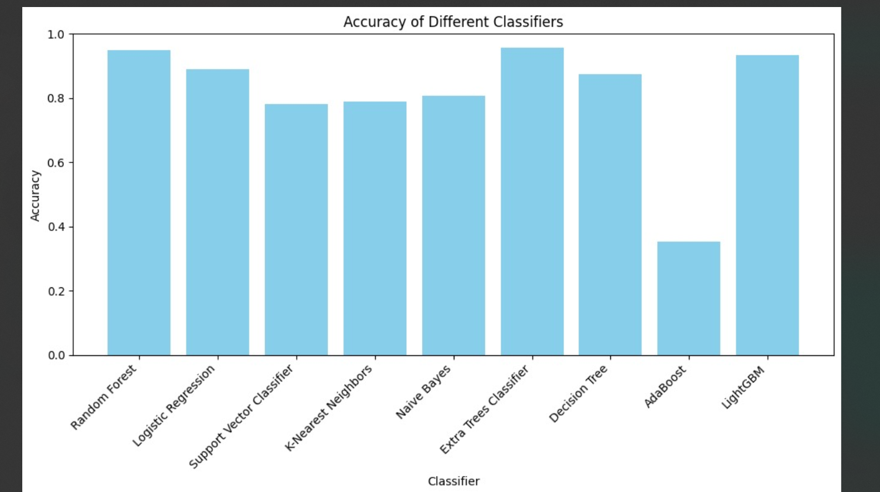
Accuracy of different algorithms:

Slide 39
CONTRIBUTIONS:
PROBLEM SOLUTION AND STATEMENT , DATA COLLECTION , ACCURACY OF ML MODELS - AYUSH KUMAR MOURYA(2022450)
Overall design and template , Feature Reduction and PCA - JAS KEERAT SINGH(2022226)
LEUKAEMIA RESEARCH , VOLCANO PLOT , HEAT MAP - SARGUN SINGH KHURANA(2022450)
Labelling the data and APPLYING ML ALGORITHMS DL model, PCA - SYED(2022530)
NORMALISATION and removing null values - TUSHAR(2022545)

Slide 40
RESOURCES REFERRED:
https://www.nature.com/articles/s41598-022-04835-6#Sec3
https://www.ncbi.nlm.nih.gov/geo/query/acc.cgi?acc=GSE28497
https://www.pennmedicine.org/cancer/types-of-cancer/leukemia/types-of-leukemia
https://www.ncbi.nlm.nih.gov/geo/query/acc.cgi?acc=GSE9476

